Slide 1
Common Knowledge in Research
Version 1.3 by Sherry on May 22nd, 2020
Notes
The slides CANNOT cover all the common knowledge you need to know for research. DO NOT be shy to ask if your have questions that do not have answers from Google.
Please READ the policies and guidelines of the conference websites before your submission BY YOURSELF. You can learn a lot. DO NOT BE LAZY.
Please attend PDEV6770 and LANG5001. Keep all the things you have learned in mind.

Slide 2
How to Present Ideas to the Others?
This is the content you need to write in your Introduction.
Describe the problem
Is this problem important? Or just some rare cases in real-world scenarios? Is there any statistics or existing publication that proves its importance? Do you have motivating examples?
Present a summary of the solutions of the previous works
What are the drawbacks of these previous works?
Present the general idea of your solution
Why it is better than the previous works?
Present the technical challenges (2~3 challenges) of your solution
Is it just an engineering modification or combination of the previous works?
if parts of your work are based on any previous work, do you clarify the border between previous works and your contributions?
Make sure you can answer each of these questions CLEARLY before you present.
Notes: We present the idea to our supervisors and group members to seek for comments and advices. They can give their opinions whether your idea is feasible and convincing. DO NOT ask them to directly give you the complete solution. Otherwise they can do another PhD based on your topic.

Slide 3
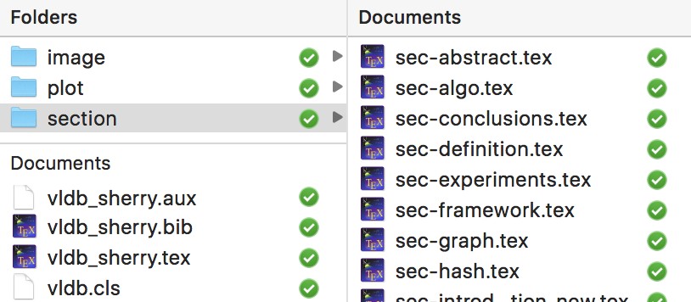
Which Tools to Use to Write Papers?
Paper Writing: LATEX
Tutorial: http://www.docs.is.ed.ac.uk/skills/documents/3722/3722-2014.pdf
Useful applications: TextStudio https://www.texstudio.org/
Collaboration with other people
Github
Dropbox
Overleaf
TIPS: Organize the files in folders, so that you and your collaborators can work on different parts of the paper without conflict.

Slide 4
How to Write Good Papers?
Paper writing is as important as actual works:
Treat your paper as a textbook that will be published instead of an experimental report or a course report.
If you are not a native English speaker and this is the first time you submit a research paper, it is better to revise each section AT LEAST THREE TIMES.
Check the spelling and grammar BY YOURSELF before passing the paper to your coauthors and supervisors. DO NOT use them as Grammarly.
Ask your friends for help. Let them read your paper and tell you which parts they cannot understand. Revise that parts by yourself until everyone understands everything in the introduction and abstract. The key idea of a good paper should be understood by any undergraduate student.
Reviewers may accept your paper if they understand your idea and solution CLEARLY.
They will definitely NOT accept your paper if it looks complicate and hard to follow.

Slide 5
How to Write Good Papers?
Suggestions:
Use good notations. You need to decide which notations to use at the very beginning of your work. DO NOT wait until you finish all the writing. DO NOT use too many notations in one paper, it confuses the readers.
Use examples (with figures) to demonstrate your algorithms or workflows.
Be concreate (especially in experiment discussion). Concreate numbers (e.g., “87.3%”) are ALWAYS BETTER than “many/a large number of/a few/largely improve/slightly improve”.
Explain every technical phrase (e.g., “global similarity”) when it appears in your text for the first time.
Use vector graphics (pdf, svg, eps…) instead of raster graphics (jpeg, gif, …).
Avoid redundant patterns/words/sentences in the text. Try to use synonyms and different sentence patterns to express the same meaning.
Make the “a/an, the, (plural)” in your paper correct!!! Otherwise it always confuses your readers!
“We work on a KB.” → We work on one KB. No specific.
“We work on KBs.” → We work on all KBs. No specific.
“We work on the KB.” → We only work on the specific KB that we mentioned above.
P.S. You can send your draft to the grammar tutor of our department (dalton AT cse.ust.hk). She will check your grammar and send some feedbacks after one week. However, she is not an expert in understanding your technical details. You need to check most of the technical parts BY YOURSELF.

Slide 6
What is Important in Paper Format?
Capitalize the titles of your sections and subsections
Use bullet points (\begin{itemize}), bold fonts, and italic fonts to highlight the important parts
Leave a space between words and citation, e.g., “Kruskal algorithm [1]”, not “Kruskal algorithm[1]”. Use “~\cite{}” in LaTex.
In the References section, make sure each citation has the same format
M. C. Phan, A. Sun, Y. Tay, J. Han, and C. Li. Pair-linking for collective entity disambiguation: Two could be better than all. Transactions on Knowledge and Data Engineering, 31(7):1383–1396. IEEE, 2018.
Z. Fang, Y. Cao, Q. Li, D. Zhang, Z. Zhang, and Y. Liu. Joint entity linking with deep reinforcement learning. The World Wide Web Conference, pages 438–447. ACM, 2019.
Choose either style. Use one style for all the papers.
M. C. Phan, A. Sun, Y. Tay, J. Han, and C. Li. Pair-linking for collective entity disambiguation: Two could be better than all. TKDE, 31(7):1383–1396. IEEE, 2018.
Z. Fang, Y. Cao, Q. Li, D. Zhang, Z. Zhang, and Y. Liu. Joint entity linking with deep reinforcement learning. WWW, pages 438–447. ACM, 2019.
DO NOT just copy and paste the BibTex from Google Scholar. Most BibTex from Google Scholar is messy. Check and Fix it by yourself. DO NOT BE LAZY!!

Slide 7
What Conferences/Journals Do We Target At?
Conferences (you need to be aware of the deadlines every year):
SIGMOD (2 ddls, usually one in July, the other in October), 14 pages
PODS (2 ddls, usually one in June, the other in December)
VLDB (ddl on 1st of each month ), 12 pages
ICDE (2 ddls, usually one in June, the other in October), 12 pages with references
KDD (February), 9+2 pages
Other top conferences in ML, such as ICML, NeurIPS, AAAI, IJCAI, ICLR…
Journals:
TKDE, VLDBJ, TODS…
Suggestions:
Schedule a recycle plan. You need to know the notification date of each conference every year. If a paper is rejected from the first submission, estimate the time to revise the paper and prepare to submit it to one of the next closest deadlines.
Check the conference websites for new publications and keynotes, to follow the hot topics. e.g., https://sigmod2020.org/sigmod_research_list.shtml

Slide 8
What is Important During Paper Submission?
Fill in “Domain Conflict”:
ust.hk; connect.ust.hk; cse.ust.hk
Do not enter public webmail providers as institution domains
And the domains of your coauthors
DO NOT miss anyone!! This is important in academic honesty.

Slide 9
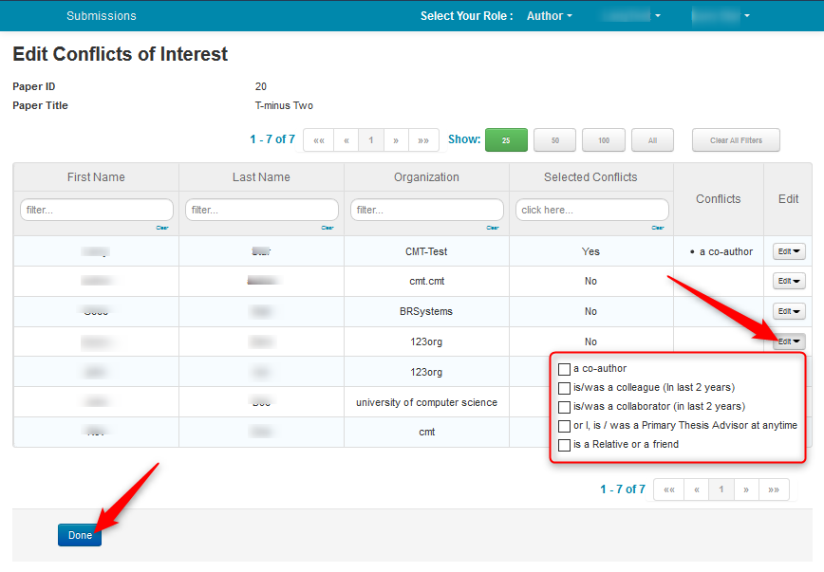
What is Important During Paper Submission?
Fill in the Conflict of Interest List (COI list):
Add all the recent colleagues/recent collaborators/thesis advisor/friend/relatives of all the coauthors. You may need to read their Google Scholar or DBLP.
For fairness, these people will not have chance to bid and review your paper because you are too familiar with each other.
Ask your supervisor, your senior and your coauthors if you do not know who to fill in.
DO NOT miss anyone!!! This is important in academic honesty.

Slide 10
Some Common Knowledge of Paper Reviews
Mode of Reviews
Single-blind: The reviewers can view the names of author, but the author does not know who the reviewers are. (e.g., VLDB, ICDE, applied science track of KDD)
Double-blind: The reviewers cannot view the names of author, and vice versa. (e.g., SIGMOD, research track of KDD)
Triple-blind: The reviewers and handling editors (PC chairs) cannot view the names of author, and vice versa. (e.g., ICDM)
Open review: The paper review is public. Anyone can review and comment the paper. (e.g. ICLR) https://iclr.cc/archive/www/doku.php%3Fid=iclr2017:faq.html)
DO NOT submit low-quality papers to single-blind conferences. This damages the reputation of you and your coauthors.
Notes:
Check the conference websites for the modes of reviews every time before your submission.
For conferences in double-blind and triple-blind, you should not leak any information about your identities in the paper. DO NOT mention your name, your affiliations, your github address, the arXiv version of your paper (if there is any).
Different conferences have different rules in different years. Make sure you read EVERY WORD in the submission guideline. DO NOT BE LAZY!!

Slide 11
Some Common Knowledge of Paper Reviews
What will happen after you submit the paper?
Reviewers bid for papers they want to review: During bidding, reviewers can access abstracts of all non-conflicting papers. They can bid as per their expertise and interest.
Reviewers read the papers and write comments. The common aspects include:
Originality/Novelty of the paper
Technical Quality of the paper
Impact/Outreach of the paper
Presentation
Reproducibility
Three positive aspects of the paper
Three negative aspects of the paper
TIPS: Before submission, you may read the list of PCs (e.g., http://sigmod2020.org/org_sigmod_pc.shtml , or in the COI candidate list) in the conference website and guess who will bid for your paper. Make sure you discuss or cite their works properly in your paper.
TIPS: Ask yourself the SAME QUESTIONS before you submit. What scores will you give to your paper regarding each of these issues if you are a reviewer? Do you really want to submit?

Slide 12
Some Common Knowledge of Paper Reviews
What will happen after you submit the paper?
A discussion is usually initiated by the Chair or Meta-Reviewer after reviews have been submitted for papers with divergent recommendations. Reviewers’ identities can be shared or kept anonymous during discussion.
Make sure your idea convinces everyone!
P.S. Usually (for most conferences and journals) there will be three reviewers for one paper. Sometimes if it is hard to decide whether a paper should accepted or rejected, the meta-reviewer or chair may invite one or two more reviewers for a paper.
If you want to know more details about the review process, you can read some guidelines in CMT: https://cmt3.research.microsoft.com/docs/help/index.html (In the “How To” section, there is a introduction about what chairs/meta-viewers/reviews will do during the review).
Anyway, the most important thing is to submit a good work!!

Slide 13
How to Make Good Slides for Presentation?
This is applicable to both idea presentation and paper presentation in the conference.
Make an Outline
Background and Motivation (to make the audiences understand your problem)
Existing Solutions and Their Drawbacks
Your Solution/Framework/Algorithms
Experimental Results
DO NOT put too many words in one page
Use bullets points instead of large paragraphs of text
Use figures and animations to demonstrate a simple running example of your algorithm
Insert page number in each page, so that it is convenient for the audiences to ask questions
Prepare some backup slides that demonstrate technical details of your solution, or any problems that the audiences may ask

Slide 14
How to Be a Qualified PhD?
Be self-motivated. Time flies!
Have the ability to conduct research independently.
Seek for knowledge BY YOUSELF.
DO NOT wait for your supervisors and seniors to give good ideas/pass good papers/pass good tutorials to you. Search them by yourself. Think by yourself.
DO NOT wait for the others to tell you the answers. Seek for the answers by yourself. You have Google. DO NOT be shy to ask if there is no answer from Google.
You are not an undergraduate student any more. DO NOT accept knowledge passively. Seek for knowledge actively.
Talk with your friends/group mates/lab mates/roommates/classmates (I believe at least one of them is doing PhD as well). Learn something from their research habits and experience.
This is the most important ability of PhD.

Slide 15
Plagiarism
This is a very important issue, which is strongly related to the reputation of your supervisor and every group member.

Slide 16
Plagiarism (Defined from ACM Society)
Different societies have different policies. But most of them are similar. We take the policies from ACM as an example here.
Level I - Incidental violation:
Verbatim copying of small portions (less than 2 sentences) of another author's paper with citing, but not clearly differentiating what text has been copied (e.g., not applying quotation marks correctly),
Or not citing the source correctly,
Or self-plagiarism/redundant publication, if there are citations but they are poorly placed or misleading
Penalty:
Write a letter of apology to parties (e.g., editors, authors of prior works, co-authors) identified during the investigation, including an admission of wrong-doing.
Published items in the ACM Digital Library will be updated with a corrigendum noting the reasons for change and addressing the issue. Unpublished items will be rejected without further review.

Slide 17
Plagiarism (Defined from ACM Society)
Level II - Low-level violation:
Verbatim copying of small portions (more than 3 sentences) of another author's paper with citing, but not clearly differentiating what text has been copied (e.g., not applying quotation marks correctly),
Or not citing the source correctly,
Or self-plagiarism/redundant publication, without citations
Penalty :
Write a letter of apology to parties (e.g., editors, authors of prior works, co-authors) identified during the investigation, including an admission of wrong-doing.
Published items in the ACM Digital Library will be withdrawn. Unpublished items will be rejected without further review.

Slide 18
Plagiarism (Defined from ACM Society)
Level III - Moderate violation:
Verbatim copying,
Or near-verbatim copying,
Or purposely paraphrasing several elements of another author‘s work,
Or copying elements of another author's work without citing the sources or without clearly delineating the source material
Penalty:
Write a letter of apology to parties (e.g., editors, authors of prior works, co-authors) identified during the investigation, including an admission of wrong-doing.
Published items in the ACM Digital Library will be withdrawn. Unpublished items will be rejected without further review.
Banned from contributing to any related ACM Venue for a full calendar year.
A letter explaining the violation, findings, and penalties will be sent to the Dean, chair, or supervisor of each party found in violation.

Slide 19
Plagiarism (Defined from ACM Society)
Level IV - Significant violation:
Verbatim copying,
Or near-verbatim copying,
Or purposely paraphrasing a significant portion of another author's work without citing the sources and without clearly delineating the source material
Penalty:
Write a letter of apology to parties (e.g., editors, authors of prior works, co-authors) identified during the investigation, including an admission of wrong-doing.
Published items in the ACM Digital Library will be withdrawn. Unpublished items will be rejected without further review.
Banned from submission to any ACM Venue for the next two years.
A letter explaining the violation, findings, and penalties will be sent to the Dean, chair, or supervisor of each party found in violation.

Slide 20
Plagiarism (Defined from ACM Society)
Level V - Severe violation:
Repeated violations (contains two or more violations mentioned above)
Penalty:
Write a letter of apology to parties (e.g., editors, authors of prior works, co-authors) identified during the investigation, including an admission of wrong-doing.
Published items in the ACM Digital Library will be withdrawn. Unpublished items will be rejected without further review.
Banned from submission to any ACM Venue for the next five years.
The case and evidence will be forward to the ACM Committee on Professional Ethics for consideration.
A letter explaining the violation, findings, and penalties will be sent to the Dean, chair, or supervisor of each party found in violation.

Slide 21
Plagiarism
Policies:
ACM (applicable to SIGMOD, KDD…) https://www.acm.org/publications/policies/plagiarism-overview
IEEE (applicable to ICDE, ICDM…) https://www.acm.org/publications/policies/plagiarism-overview Section 8.2.4d, Page 105
VLDB https://www.vldb.org/pvldb/policies.html
Please attend PDEV6770 seriously. There are sessions such as Publication Ethics, Academic Integrity & Intellectual Property, and Research Ethics Case Studies. Most of these sessions are compulsory for all HKUST RPG students. The contents include (but not limited to):
Judging What is Plagiarism & How to Avoid It
Differences between Plagiarism and Copyright Violation
Hong Kong Copyright Law and Legitimate Use and Fair Dealing
HKUST Intellectual Property Policies
Please keep everything you have learned in mind.

Slide 22
Plagiarism
Conclusions:
Cite EVERY paper and material you refer to during your writing/coding properly.
DO NOT USE DIRECT QUOTES From Published Material: In 99.99% of the cases, the information you want from a research article is an objective result or interpretation. How the author stated this information, i.e., their prose, is of little importance compared to the results or interpretations themselves. Take the information and put it into your own words; avoid paraphrasing since this can potentially lead to plagiarism.
Draw EVERY component in the figures BY YOURSELF. DO NOT CROP others’ figures.
If a theorem is already proved in another work, cite that work and use the theorem. DO NOT write the proof again.
DO NOT copy anything from your previous papers or any paper of your coauthors. This is self-plagiarism. All the penalties apply to self-plagiarism.
DO NOT ask questions such as “I think this paper has also copied something from that paper, why it is not punished?”. Others are idiots does not mean that you also have to be an idiot.
A paper will be related with the reputation of you and your coauthors for a whole life time. DO NOT take any risk.

Slide 23
Wish You All The Best in Your Research Path
I sincerely acknowledge all the collaborators of my previous works and my group members for sharing their good research habits and experience with me.
I also acknowledge my friends, Richard, Rongxin, Yepang and Ying, for sharing their common knowledge of research with me. ☺
Feel free to share your comments and knowledge in the slides!

